Slide 1
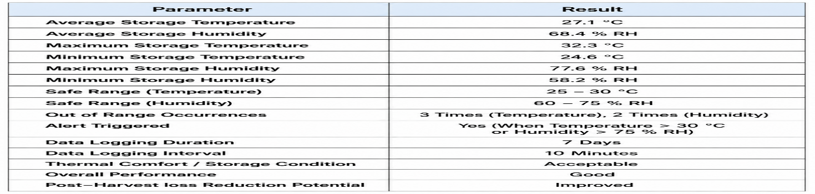
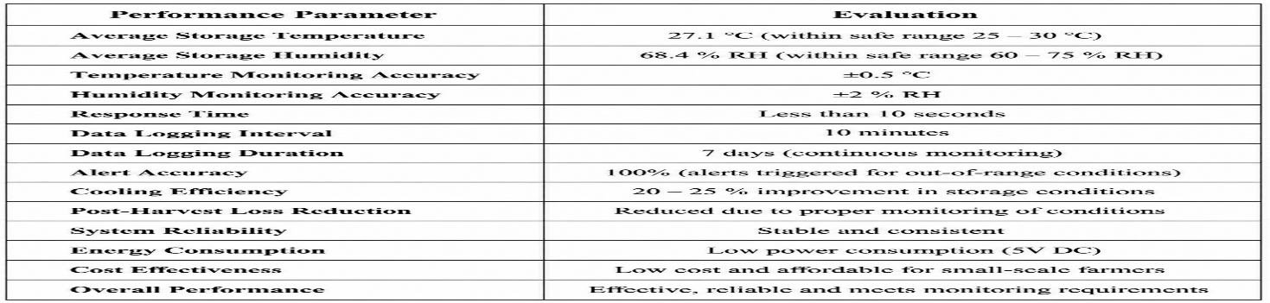
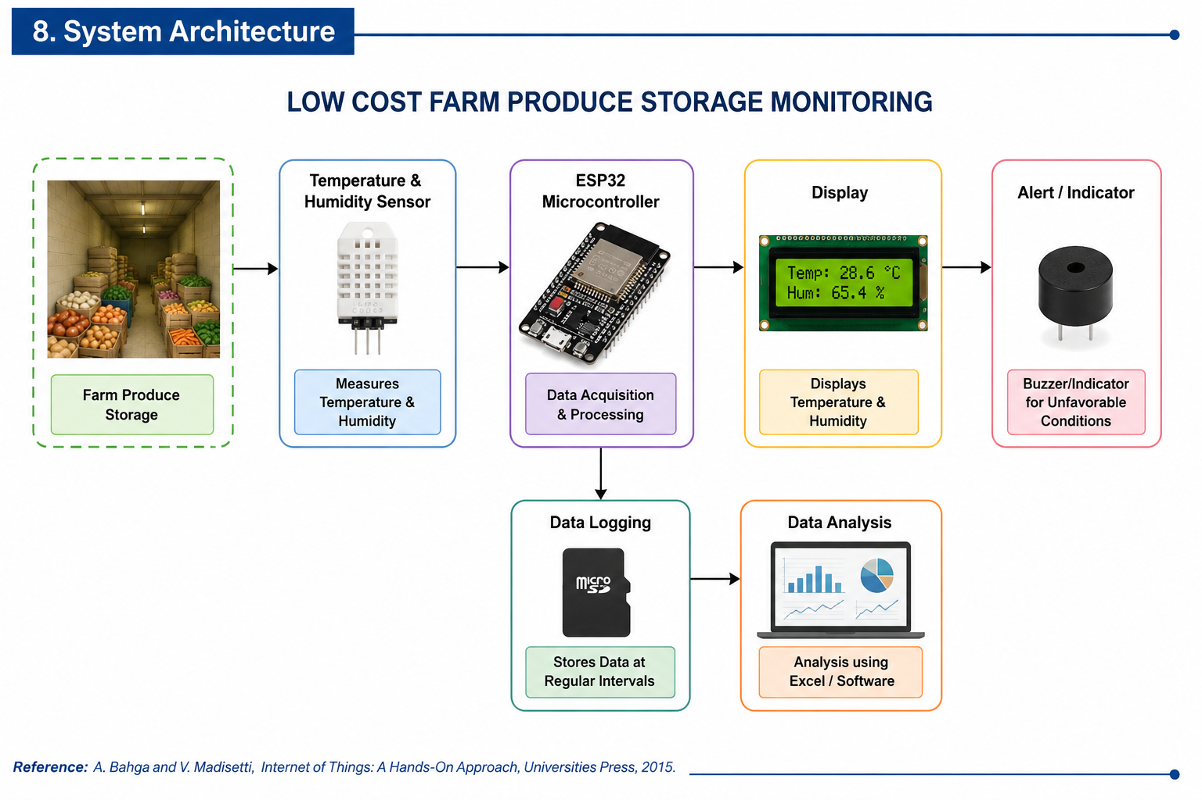
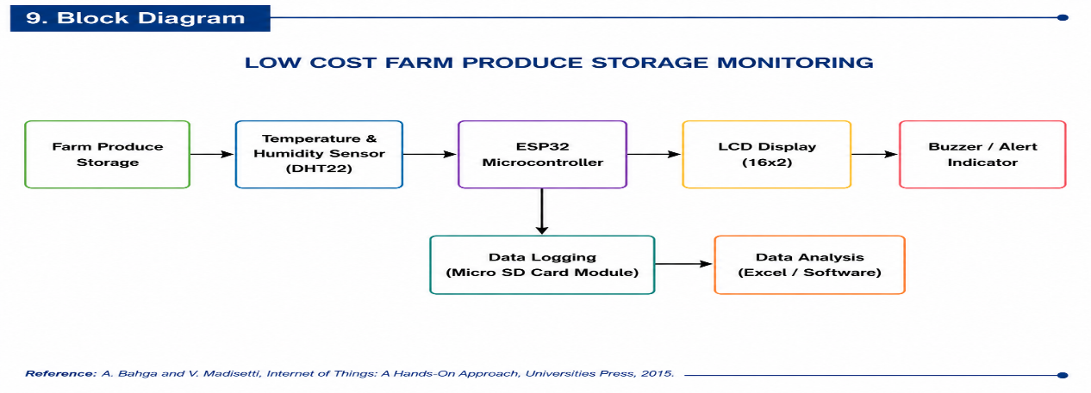
LOW COST FARM PRODUCE STORAGE MONITORING SYSTEM
Project Abstract
This project presents a low-cost monitoring system for farm produce storage that helps maintain suitable storage conditions by monitoring temperature and humidity. An ESP32-based system with temperature and humidity sensors continuously measures the storage environment. The collected data can be recorded and analyzed to identify unfavorable conditions that may cause spoilage. The proposed system is affordable, energy-efficient, and suitable for small-scale farmers and low-cost storage facilities.
Problem Statement
Farm produce can deteriorate due to unsuitable temperature and humidity conditions during storage. Small-scale farmers may not have access to expensive monitoring systems. Manual checking of storage conditions is also time-consuming and may not provide continuous monitoring. Therefore, there is a need for a low-cost system that continuously monitors storage conditions and helps prevent post-harvest losses.
Need for the Project
Reduce post-harvest losses, Monitor temperature and humidity continuously, Identify unfavorable storage conditions at an early stage, Provide an affordable monitoring solution for farmers, Improve the quality and storage life of farm produce.
Project Objectives
To design and develop a low-cost farm produce storage monitoring system.
To monitor temperature and humidity inside the storage area.
To provide continuous measurement of storage conditions.
. Expected Learning Outcomes
Understand temperature and humidity monitoring.
Learn ESP32 programming and sensor interfacing.
System Requirements
Hardware:ESP32 Microcontroller ,DHT22 Temperature & Humidity Sensor , LCD,LED Display , Buzzer , Power Supply , Connecting Wires , Storage Chamber.
Software:The software includes Arduino IDE for programming the ESP32, Embedded C for code development, and Microsoft Excel for analyzing the recorded temperature data.
Methodology / Workflow
Problem Identification → Literature Survey → System Design → Component Selection → Prototype Development → Sensor Integration → Temperature & Humidity Monitoring → Data Collection → Analysis → Testing → Results & Conclusion
System Architecture
Block Diagram
Project Development Process
Problem Identification → Literature Survey → System Design → Component Selection → Prototype Development → Hardware Integration → Programming → Testing → Data Analysis → Conclusion
Implementation
A prototype storage chamber is developed to represent a farm produce storage environment. Temperature and humidity sensors are installed inside the chamber and connected to an ESP32 microcontroller. The ESP32 collects sensor readings at regular intervals and displays the storage conditions. If the measured conditions become unfavorable, an alert can be generated using a buzzer or indicator. The recorded data can be analyzed to evaluate storage conditions.
Algorithms / Models Used
Algorithm / model 1:Temperature and Humidity Monitoring Algorithm
Algorithm / model 2:ESP32-Based Temperature Monitoring and Data Logging System
Dataset / Input Data (if applicable)
Temperature and humidity readings collected from the storage environment at regular time intervals are used as input data for monitoring and performance analysis.
Experimental Setup
A small storage chamber/prototype is constructed to simulate farm produce storage conditions. A temperature and humidity sensor is placed inside the chamber and connected to an ESP32 microcontroller. The system continuously measures environmental conditions and displays the readings for monitoring and analysis.
Results
Performance Evaluation
Testing and Validation
The prototype is tested under different temperature and humidity conditions. Sensor readings are observed and compared with reference measurements to verify the monitoring performance. The alert system is also tested by creating unfavorable storage conditions.
Challenges Encountered
Challenge 1Maintaining accurate temperature and humidity measurements.
Challenge 2:Ensuring continuous operation of the monitoring system.
Solutions Implemented
Solution 1:Proper sensor placement and calibration are used for reliable measurements.
Solution 2:A simple automated monitoring and alert system is implemented for continuous operation.
Innovation / Novel Features
The proposed system combines low-cost environmental sensing, ESP32-based monitoring, and automatic alerts into a compact storage monitoring solution. It is designed specifically to provide an affordable option for small-scale farmers and storage facilities.
Applications
Agricultural storage rooms.
Small-scale farm produce warehouses.
Future Scope
The system can be enhanced with IoT-based remote monitoringMobile application connectivity, and solar-powered operation.
Project Outcomes
Successfully monitored temperature and humidity., Reduced the need for manual checking. Skills Acquired
Technical skill 1: ESP32 Programming, Embedded C, Sensor Interfacing, Prototype Development, Temperature Monitoring, Data Analysis.
Soft skill 1: Teamwork, Problem Solving, Communication, Time Management.
References
A. Bahga and V. Madisetti, Internet of Things: A Hands-On Approach, Universities Press.
Relevant research papers on post-harvest storage and environmental monitoring.
ESPRESSIF Systems, ESP32 Series Datasheet, Espressif Systems, China, 2023.
Acknowledgements
Department of Mechanical Engineering, Knowledge Institute of Technology, Salem.
Project Guide and Team Members for their valuable guidance and support
[Insert QR Code]
QR Code — Project Report (PDF) | Source Code Repository | Demonstration Video
Contact information
Department of Mechanical engineering, Knowledge Institute of Technology, Salem
Email: 2k23me054@kiot.ac.in | www.kiot.ac.in

